Slide 1
WuXi Medical Device Testing
Entering Materials Characterization Custom Chemistry Orders in WuXi Order System (WOS)

Slide 2
Table of contents (click to jump to section)
Slide 3-9: General walkthrough
Slide 10: Adding multiple lots for one test article
Slide 11: When multiple components are to be combined in one extraction
Slide 12: Adding comparison/control/supply
Slide 13-15: Ordering multiple tests on multiple test articles in one order
Please contact MDTest.ClientSupport@wuxiapptec.com or your business development manager with questions

Slide 3
General Walkthrough Simple Orders (one test article, one lot)
This section of slides guides you through the whole process using a simple order as an example. After reviewing this section, please see other supplemental sections that may apply to your quoted test.
If your quote, for example, lists comparison or control article on page 3 you may need to view those slides as well.

Slide 4
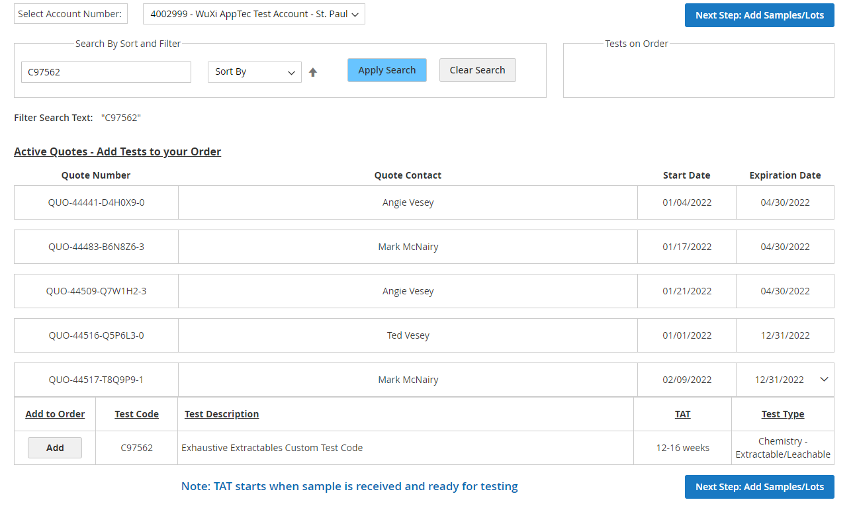
1. Start a new order by clicking Create New Order.
2. Make sure the correct Account is selected.
3. Search for a C# or find your quote in the list.
4. Click ADD on the applicable test code.
5. Click Next.

Slide 5
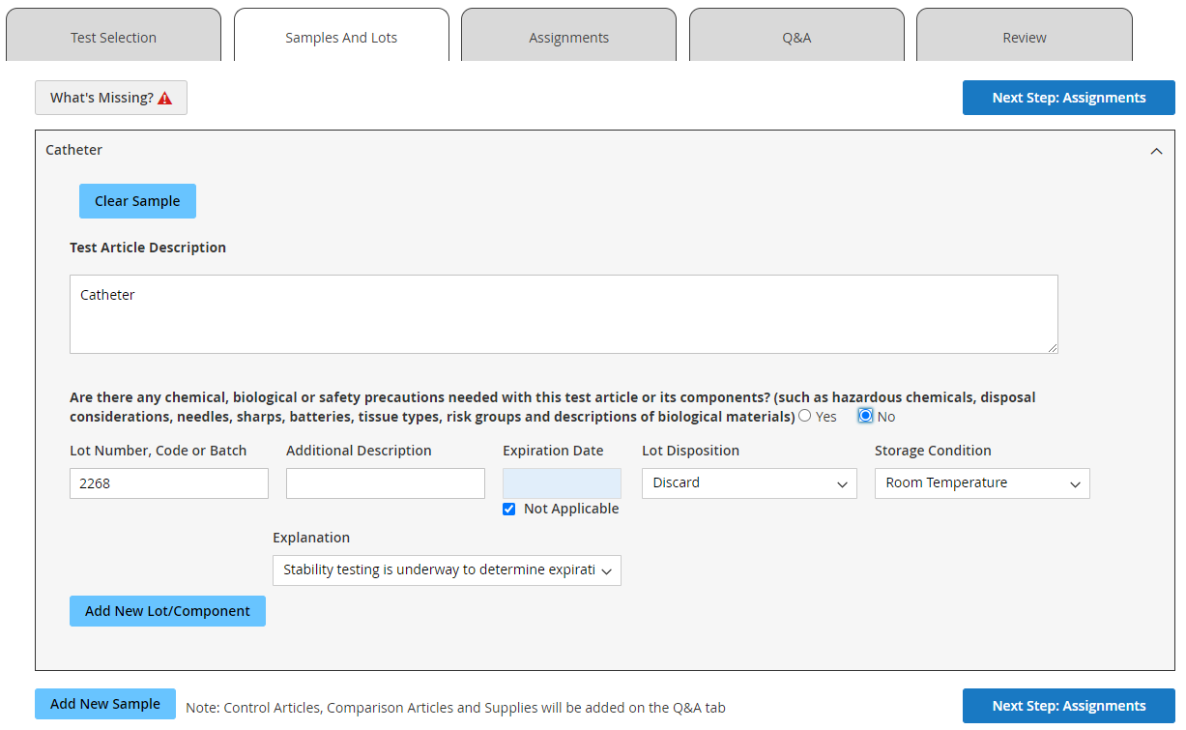
1. Fill in the Required Fields. -Test article name
-Safety statement
-Lot or ID numbers
-Expiration
-Disposition
-Storage
2. Click Next.

Slide 6
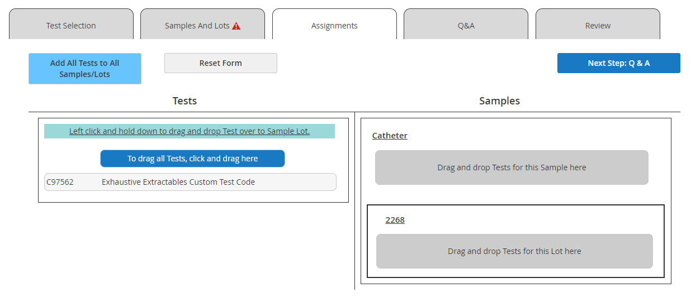
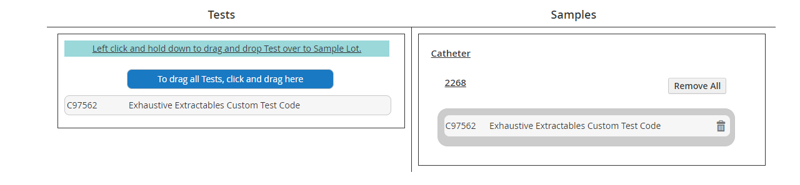
Drag and drop the Test Code from the left onto the Sample on the right.
2. Click Next.

Slide 7
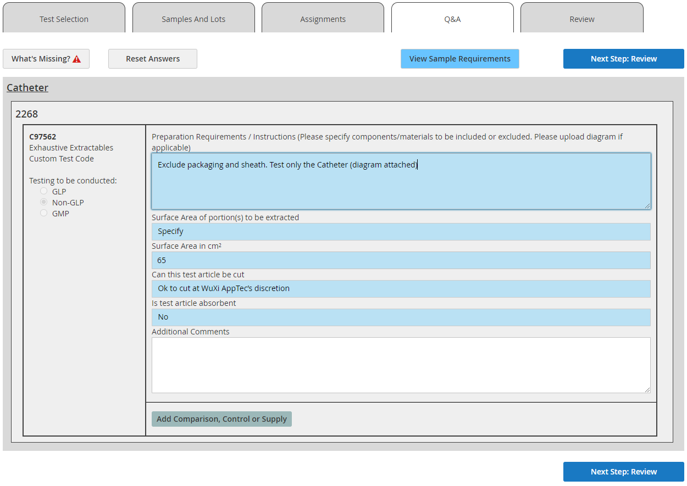
1. Fill in the Required Fields. -Preparation Requirements -Please indicate exclusions
-File upload on next tab
-Surface area
-Cut instruction
-Absorbency
2. Click Next.

Slide 8
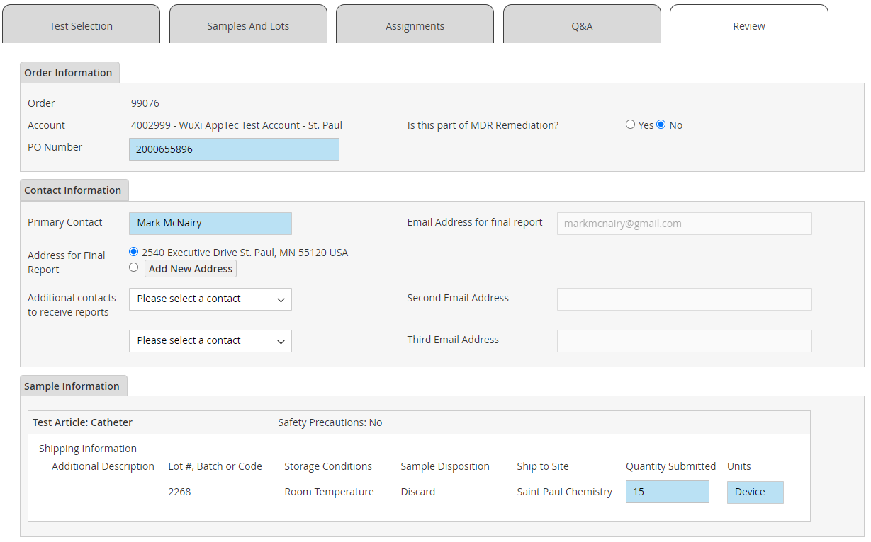
1. Fill in the Required Fields. -PO -MDR question
-Contact/Address
-Quantity being shipped
Note: If the value you are entering in the Quantity Submitted field is not greater than or equal to the minimum required on your quote (page 3), the study will be placed on hold.

Slide 9
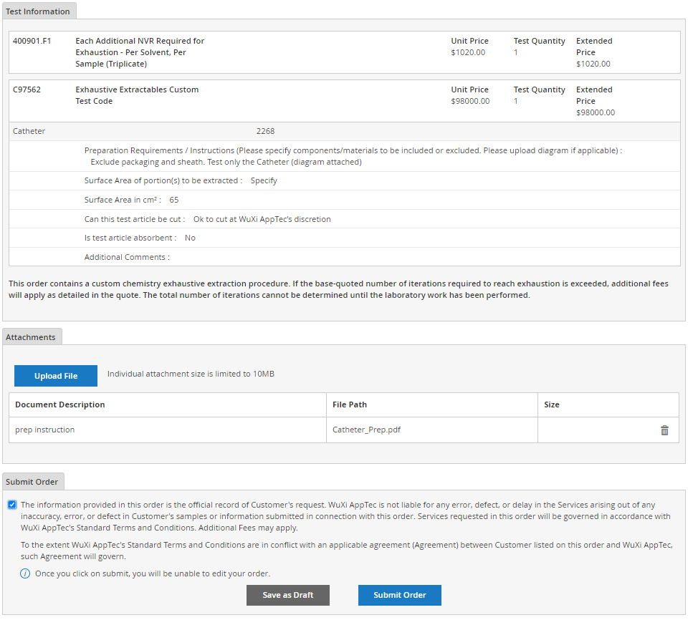
Verify Pricing is as expected. -Applicable fees not listed on quotes may be shown (e.g. exhaustive fees)
Review information Summary.
Add Attachments as applicable.
Check Confirmation statement.
Save the Draft order or Submit.
- Once submitted, orders cannot be edited. If changes are expected, save as draft, do not submit.
After clicking Submit, a Packing Slip will automatically download. Package your order and include the slip for receiving.

Slide 10
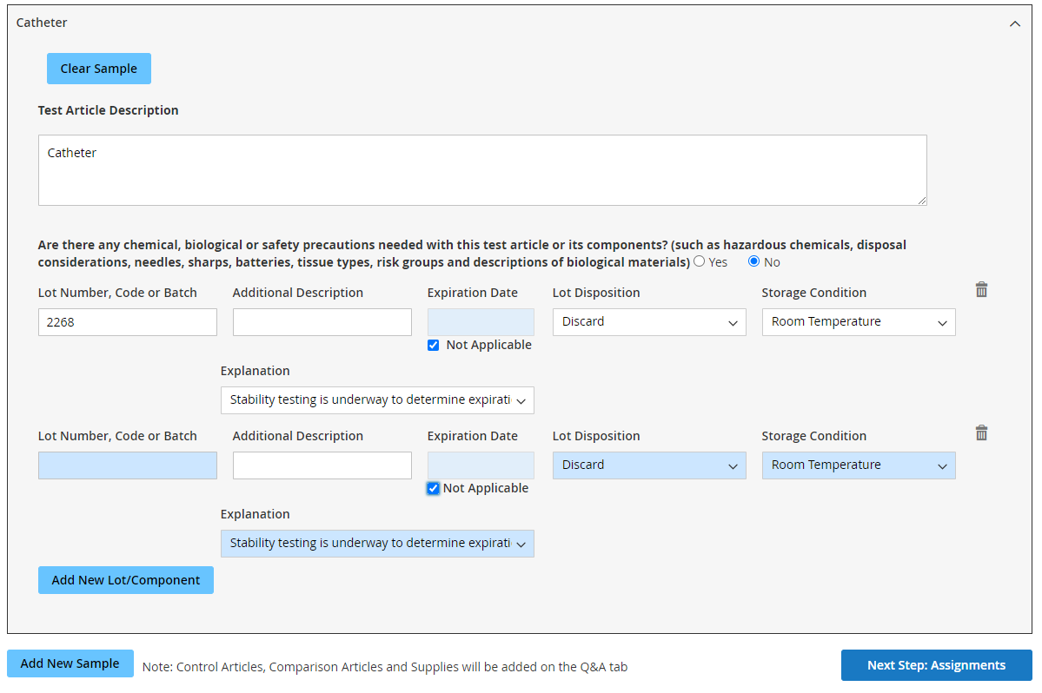
Multiple lots for one test article
Add each unique lot of the same test article by clicking Add New Lot/Component -Most fields from the 1st lot will copy down allowing a simple entry of the next lot #. -continue to add each additional lot -QTY of each unique lot submitted will be indicated later on the Review Tab (see slide 8)
Note: Please do not indicate “see attached” or similar. Submitting an order in this manner will cause delays to initiation and extension of TAT of up to a week. If devices are shipping from an external facility, please gather the lot information from your supplier prior to order entry whenever possible to avoid delays.
On the Assignments Tab choose “lots can be used interchangeably” -if you desire specific use for specific lots (per solvent, replicate etc.) detail as such in the Preparation Requirements on the Q&A Tab.
Do not use this button for new lots. This is intended for adding entirely new test articles which will result in multiple charges of the test and multiple reports if entered incorrectly. (see slide 13)

Slide 11
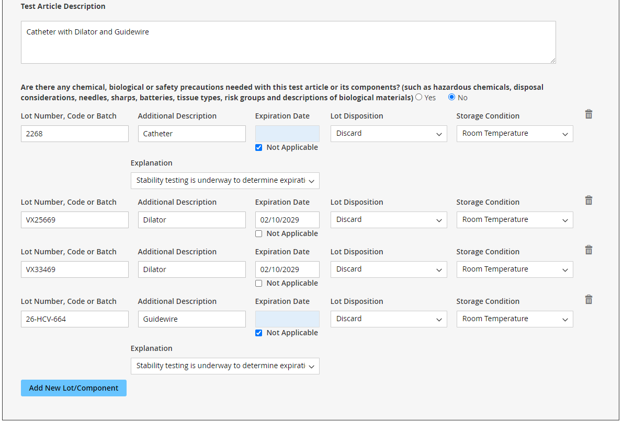
Multiple components to be combined
Please review slide 10 first, the same principles apply.
If the submission consists of multiple pieces packaged separately that will be combined to create the test article, these need to be entered separately. -Describe the test article in terms of the combined components to be extracted. -When adding new lot/component the Additional Description field is used to detail the component with applicable properties -If each component submitted has multiple lots please enter these as detailed on slide 10
On the Assignments Tab choose “Multiple components submitted to be combined as one test article”

Slide 12
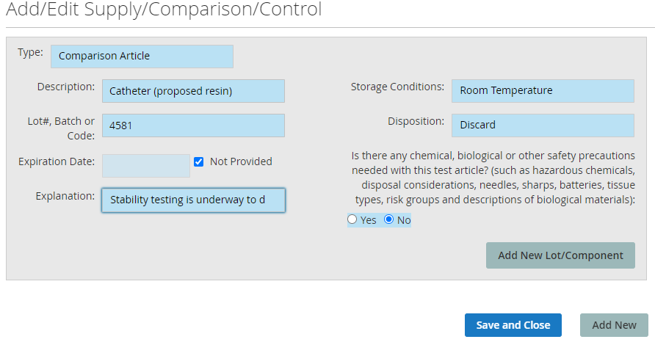
Comparison/Control/Supply
Your quote (page 3) will indicate if a comparison, control, or supply is required to be submitted. This does not include laboratory blanks (negative controls) unless specifically listed. You may also have supplies to submit that are not listed in your quote like tools for connecting, priming, or pre-conditioning. These are entered as supplies and require that you provide instruction on how to use them appropriately to avoid delays. Enter comparison/control/supply on the Q&A Tab.
Fill in the Required Fields. -The same principles apply as detailed on slide 10 and 11 for multiple lots or components using the add New Lot/Component button.
To add a completely new type (e.g. a supply vs comparison article) use the Add New Button, otherwise press Save and Close
Your added items will now show on the Q&A tab and applicable questions will appear.

Slide 13
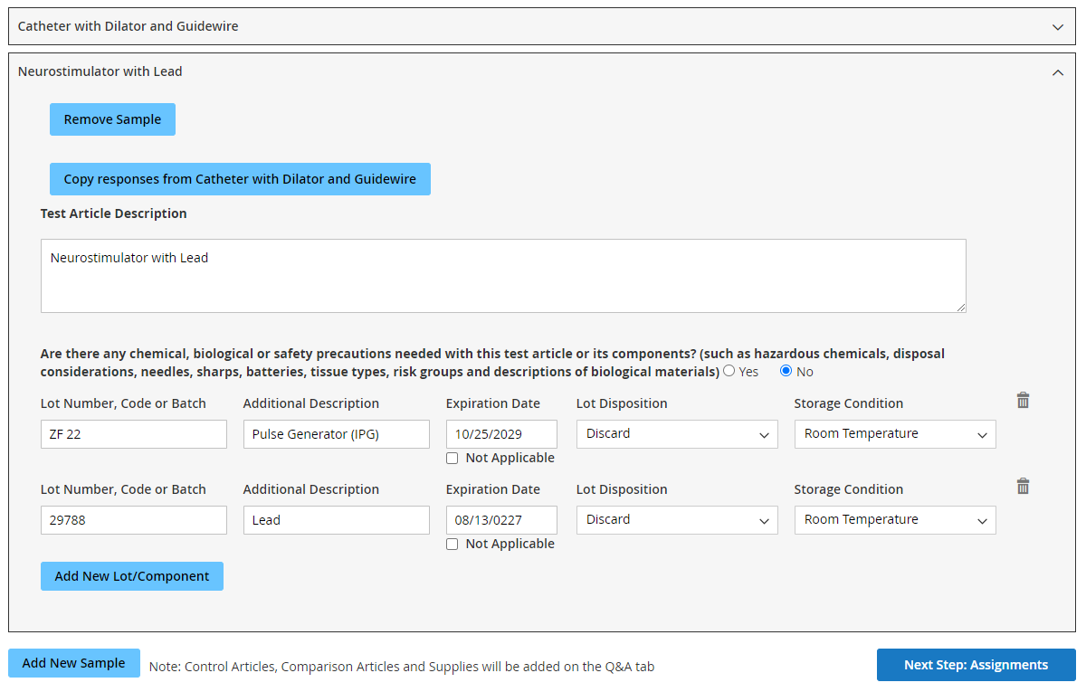
Multiple Tests, Multiple Test Articles
You may find that it is most straight forward to enter a separate WOS order for each new custom test and test article. This is especially true if your studies consist of multiple lots or components and contain comparisons and supplies. Also consider if each test has a separate purchase order.
Separate WOS orders can be boxed together if shipping to the same location as long as all applicable packing slips are included.
If you do wish to combine multiples into one order you will need to add all tests from applicable quotes (slide 4) and enter each test article separately as shown below.
Pressing Add New Sample at the bottom of the Samples and Lots Tab will collapse the first input sample (including components/lots) and open a new Sample. -All entries here are done as described on slides 5, 10, or 11 as applicable. -This can be repeated for multiple additional samples
After entering each new sample appropriately continue to the Assignments Tab

Slide 14
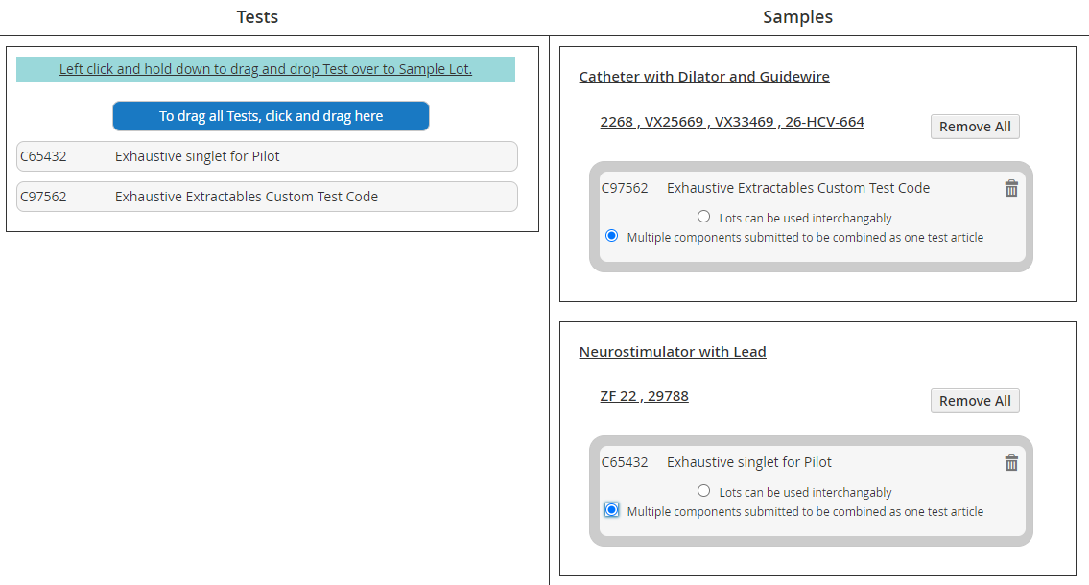
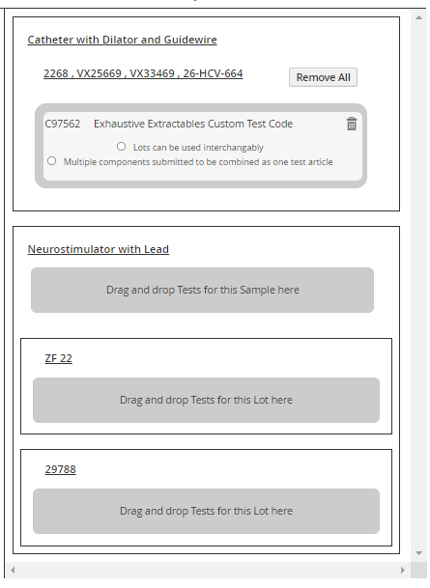
Multiple Tests, Multiple Test Articles
On the Assignments Tab all tests added and all samples entered on the order will be shown. This includes any lots or components listed under each test article.
Drag and drop each test code onto the applicable sample (not the lot/component) and it will consolidate into one question regarding how to test each.
The tabs to follow should be populated as described in slides 4-12 for each test article and test code including applicable comparison/control/supply

Slide 15
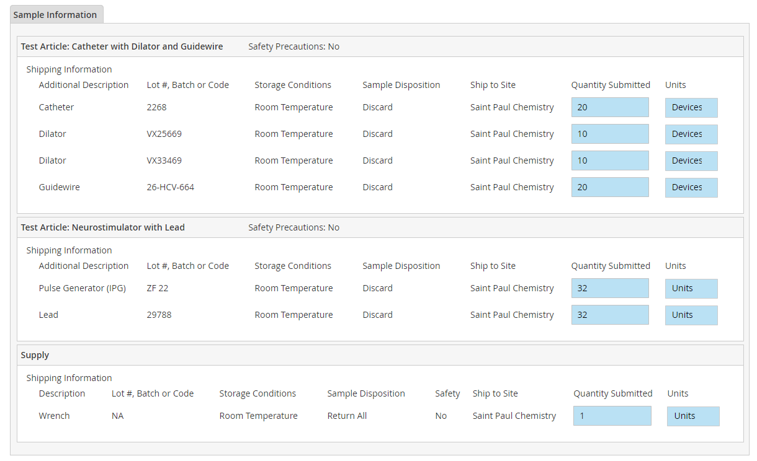
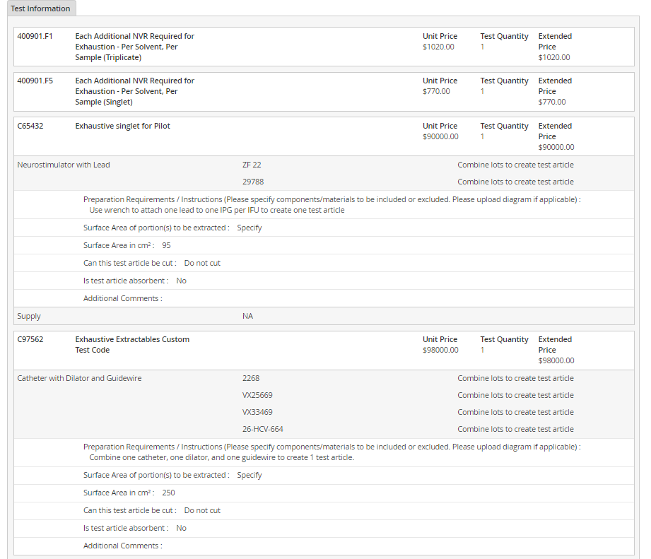
Multiple Tests, Multiple Test Articles
On the Review Tab you will see a place to indicate quantity for all portions submitted under “Sample Information”. You will also be able to confirm that everything is entered correctly by observing the charges listed, including applicable fees, as they relate to each individual quote and each individual test article in the “Test Information” section. If more than the expected charges appear it is likely that samples were entered incorrectly (slides 5, 10, 11) or test were incorrectly assigned (slide 14).

